Slide 1
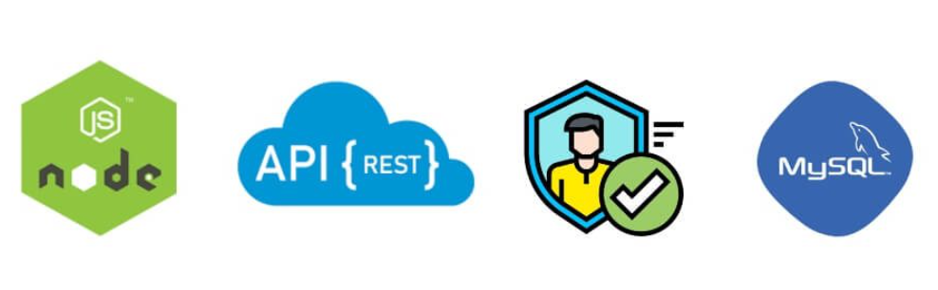
Node.js and
MySQL
Node js user Authentication using Mysql and Express js JWT

Slide 2
Team members
Alankrit
Prakash

Slide 3
Brief description about the project
Node js user authentication rest api using mysql and express js jwt bcrypt example; In this project will show you from scratch on how to build user authentication APIs (registration and login) in node.js express and mysql with jwt bcrypt.
JSON Web Tokens (JWT) are an RFC 7519 open industry standard for representing claims between two parties. For example, you can use jwt.io to decode, verify, and produce JWT. JWT specifies a compact and self-contained method for communicating information as a JSON object between two parties
JWT token based authentication rest apis in node js express mysql example; you will learn how to use or call restful apis with node js express and mysql authentication with jwt bcrypt on postman app

Slide 4
Node.js
Node.js is an open-source, cross-platform, back-end JavaScript runtime environment that runs on the V8 engine and executes JavaScript code outside a web browser. Node.js lets developers use JavaScript to write command line tools and for server-side scripting—running scripts server-side to produce dynamic web page content before the page is sent to the user's web browser. Consequently, Node.js represents a "JavaScript everywhere" paradigm, unifying web-application development around a single programming language, rather than different languages for server-side and client-side scripts.
Node.js allows the creation of Web servers and networking tools using JavaScript and a collection of "modules" that handle various core functionalities.Modules are provided for file system I/O, networking (DNS, HTTP, TCP, TLS/SSL, or UDP), binary data (buffers), cryptography functions, data streams, and other core functions.Node.js's modules use an API designed to reduce the complexity of writing server applications.
1

Slide 5
Express.js
Express is a minimal and flexible Node.js web application framework that provides a robust set of features for web and mobile applications. It is an open source framework developed and maintained by the Node.js foundation.ExpressJS is a web application framework that provides you with a simple API to build websites, web apps and back ends. With ExpressJS, you need not worry about low level protocols, processes, etc.
Express provides a minimal interface to build our applications. It provides us the tools that are required to build our app. It is flexible as there are numerous modules available on npm, which can be directly plugged into Express.

Slide 6
MySQL
MySQL is a relational database management system based on the Structured Query Language, which is the popular language for accessing and managing the records in the database.
Once you have MySQL up and running on your computer, you can access it by using Node.js.
To access a MySQL database with Node.js, you need a MySQL driver. This tutorial will use the "mysql" module, downloaded from NPM

Slide 7
RESTFUL API
REST stands for REpresentational State Transfer. REST is web standards based architecture and uses HTTP Protocol. It revolves around resource where every component is a resource and a resource is accessed by a common interface using HTTP standard methods.
A REST Server simply provides access to resources and REST client accesses and modifies the resources using HTTP protocol. Here each resource is identified by URIs/ global IDs. REST uses various representation to represent a resource like text, JSON, XML but JSON is the most popular one.

Slide 8
HTTP methods
Following four HTTP methods are commonly used in REST based architecture.
GET − This is used to provide a read only access to a resource.
PUT − This is used to create a new resource.
DELETE − This is used to remove a resource.
POST − This is used to update a existing resource or create a new resource.

Slide 9
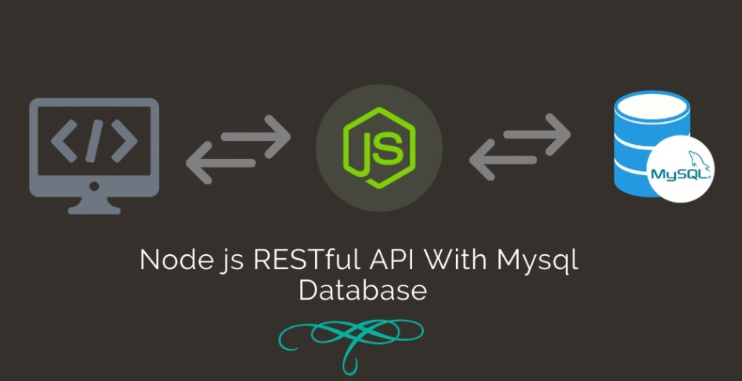
Workflow

Slide 10
Json web token(JWT)
JSON Web Token is a proposed Internet standard for creating data with optional signature and/or optional encryption whose payload holds JSON that asserts some number of claims. The tokens are signed either using a private secret or a public/private key.
For example, a server could generate a token that has the claim "logged in as administrator" and provide that to a client. The client could then use that token to prove that it is logged in as admin. The tokens can be signed by one party's private key (usually the server's) so that party can subsequently verify the token is legitimate. If the other party, by some suitable and trustworthy means, is in possession of the corresponding public key, they too are able to verify the token's legitimacy. The tokens are designed to be compact,URL-safe, and usable especially in a web-browser single-sign-on (SSO) context. JWT claims can typically be used to pass identity of authenticated users between an identity provider and a service provider, or any other type of claims as required by business processes

Slide 11
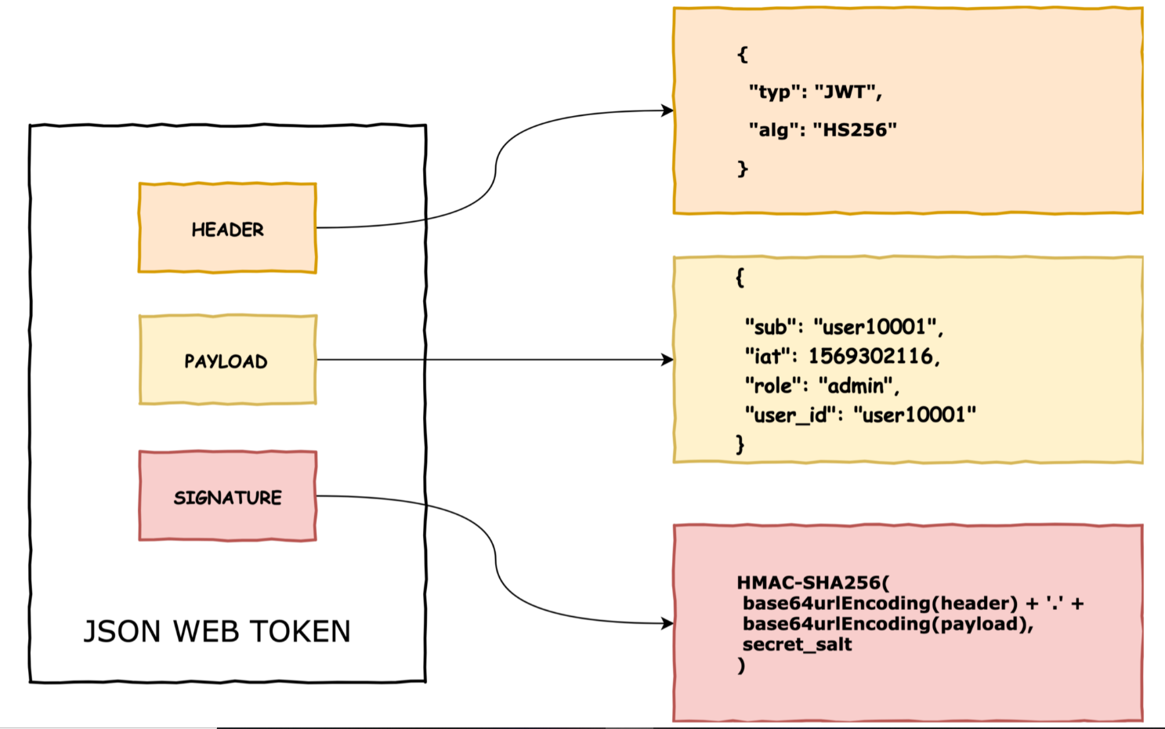

Slide 12
Build RestFul Apis with Node js Express and MySQL Authentication with JWT Auth
Step 1 – Create Database and Table
Step 2 – Create Node Express js App
Step 3 – Connect App to Database
Step 4 – Install express and required Modules
Step 5 – Create Server.js File
Step 6 – Create Validation.js, Router.js
Step 7 – Start Node Express Js App Server
Step 8 – Test Rest Apis with PostMan App

Slide 13
THANK YOU

